Slide 1
Full C# by Fakhr
Zero to hero

Slide 2
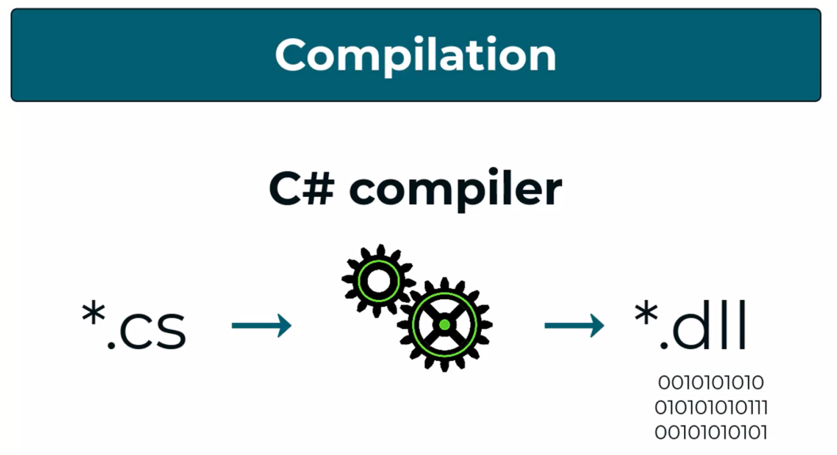
Text file to .exe

Slide 3

The most important skill

Slide 4
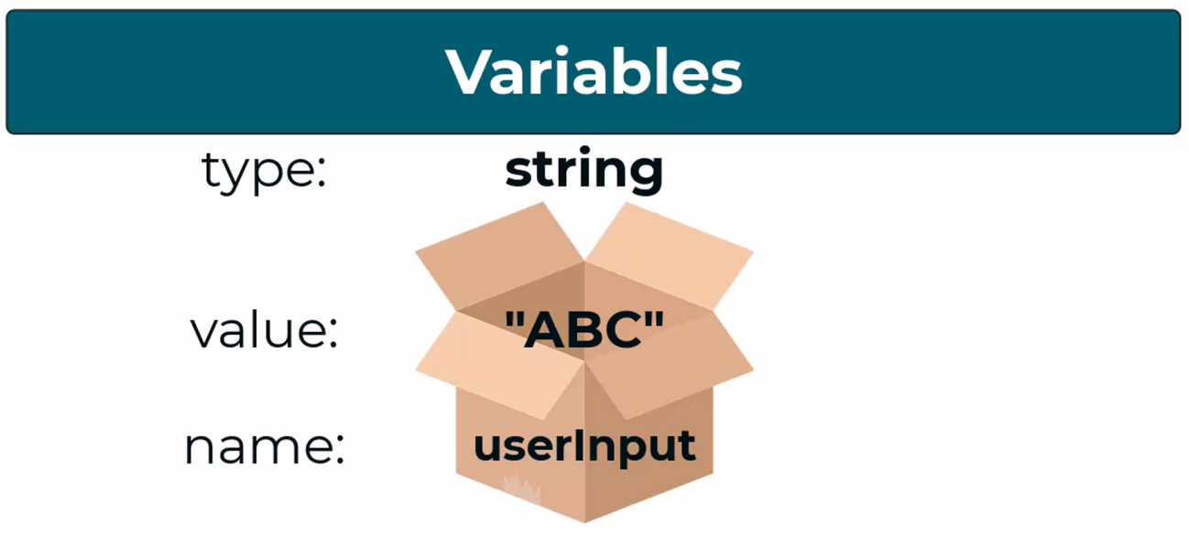
Variables

Slide 5
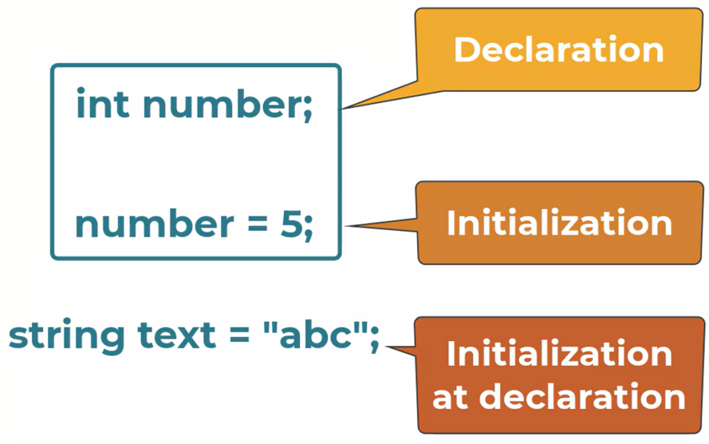
Variables

Slide 6
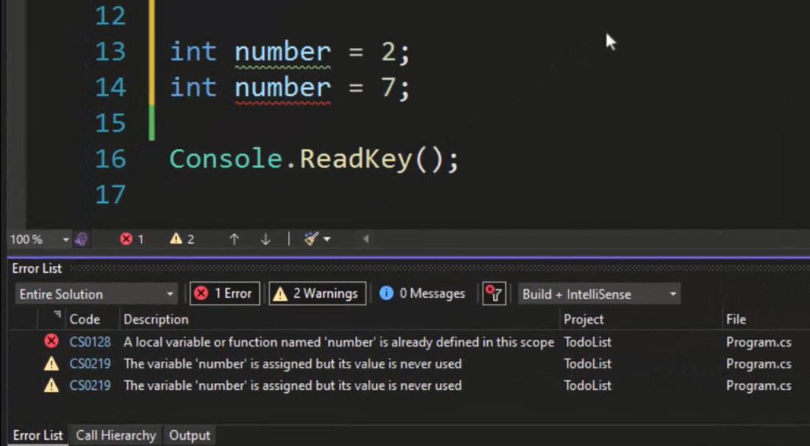
variables

Slide 7
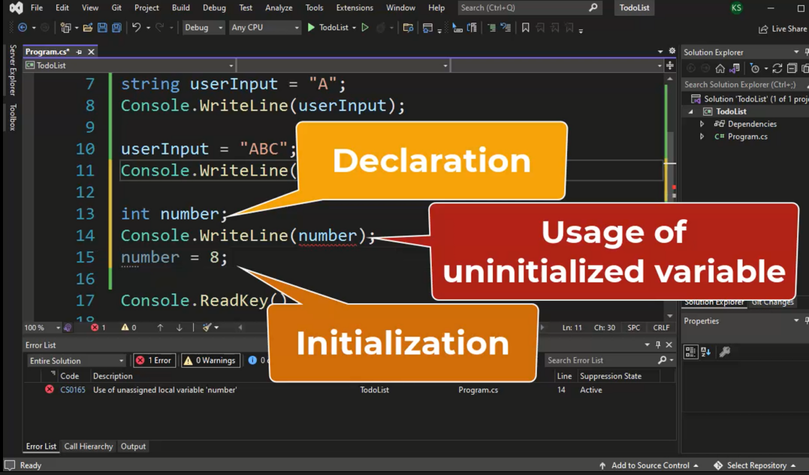
variables

Slide 8
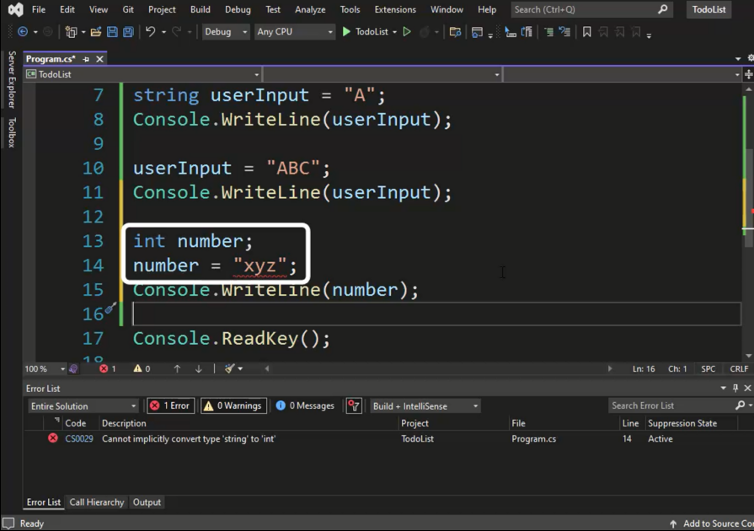
variables

Slide 9
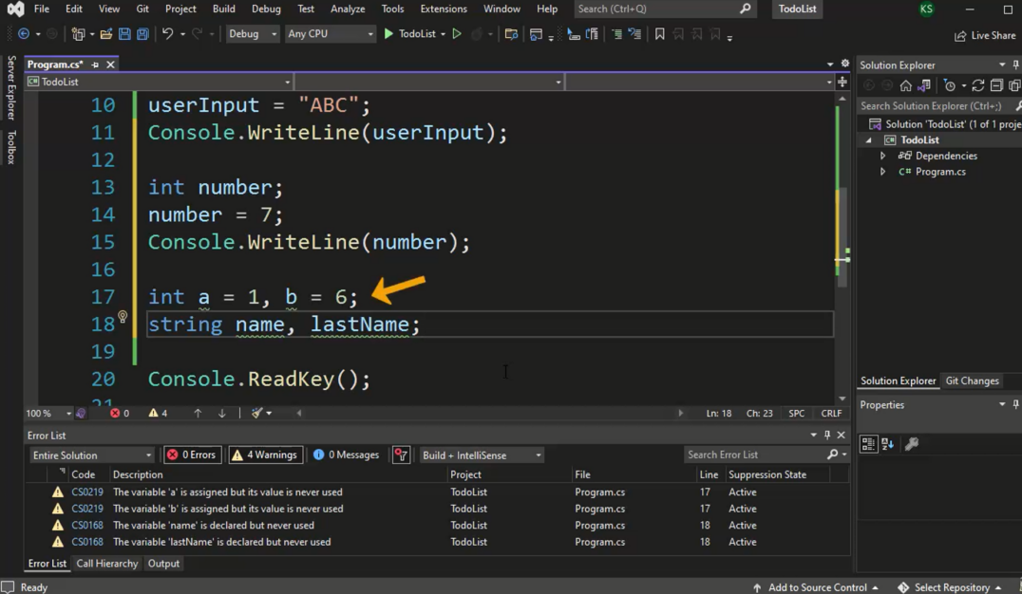
variables

Slide 10
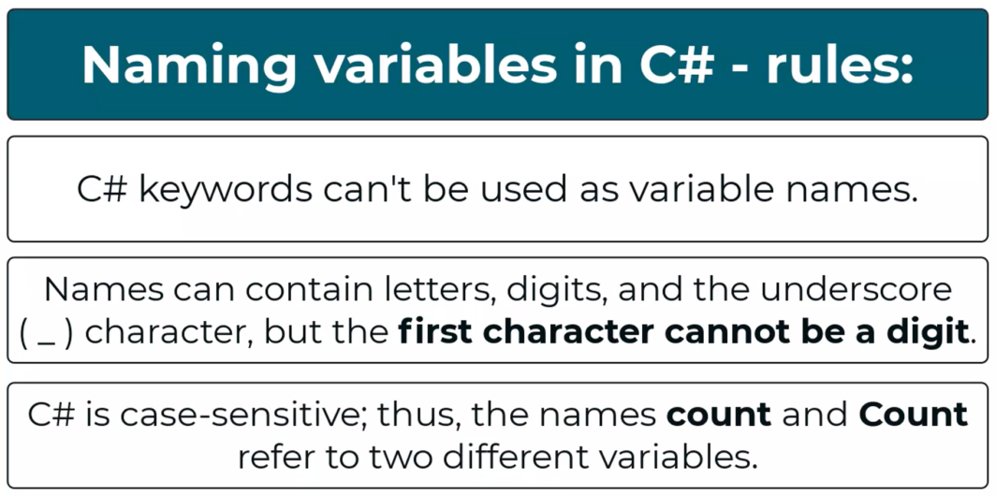
Naming
Notes:
https://learn.microsoft.com/en-us/dotnet/csharp/language-reference/keywords/

Slide 11
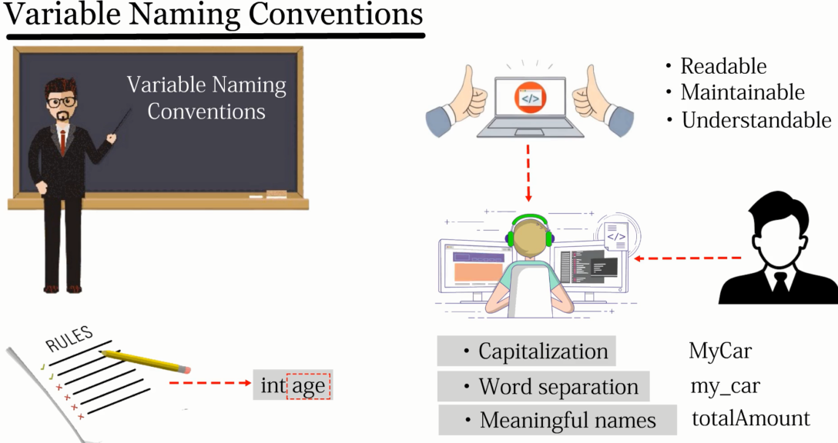
naming

Slide 12
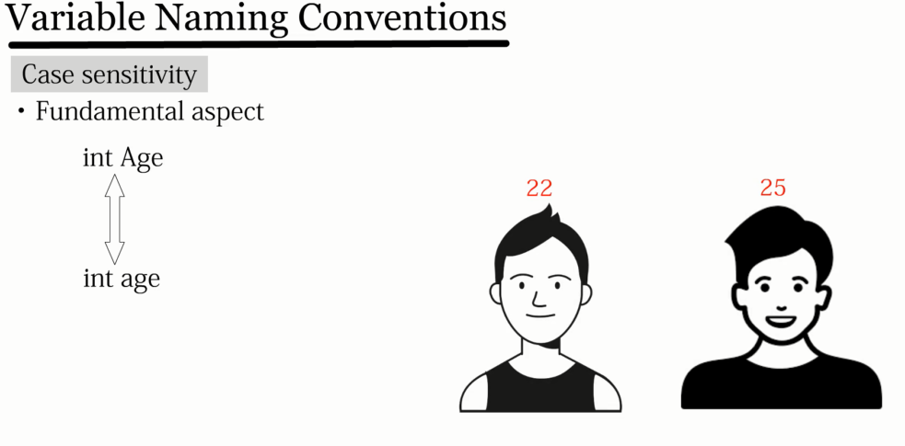
naming

Slide 13
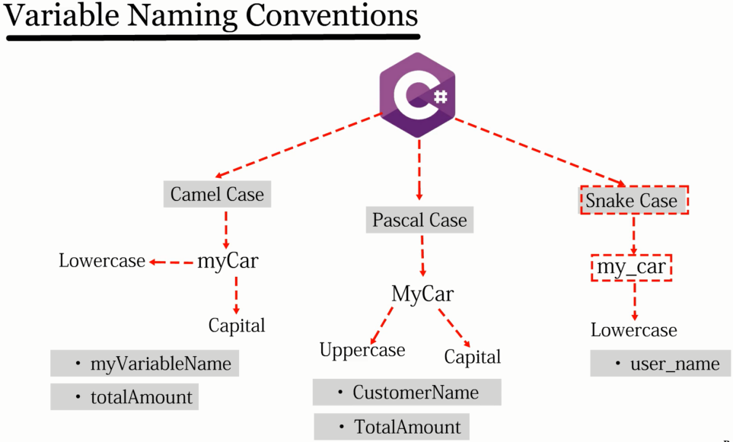
naming

Slide 14
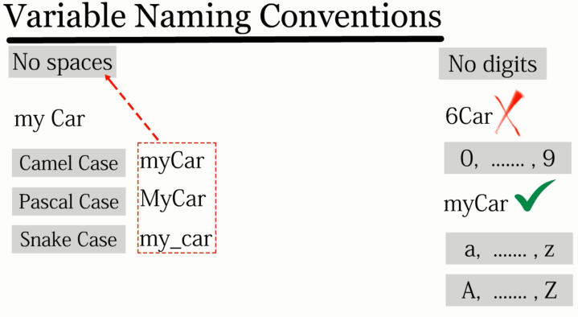
naming

Slide 15
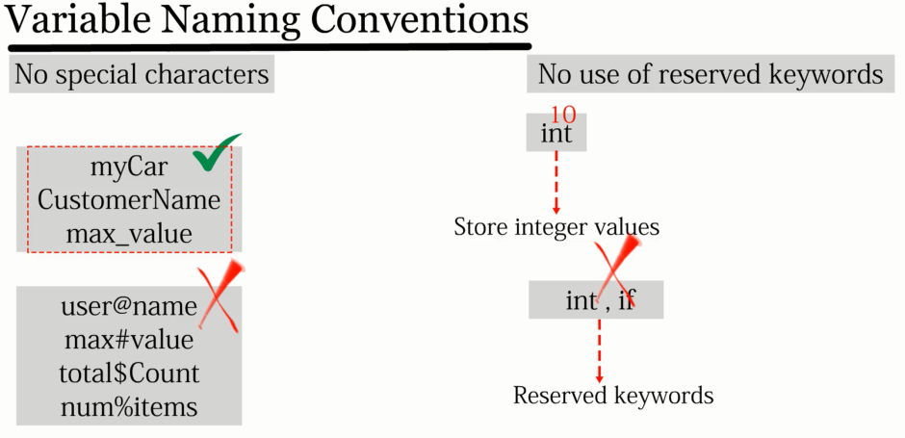
naming

Slide 16
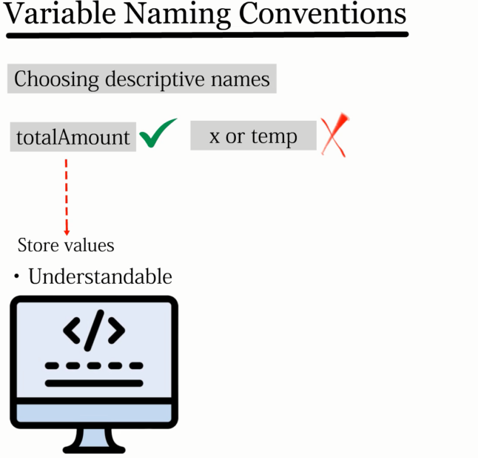
naming

Slide 17
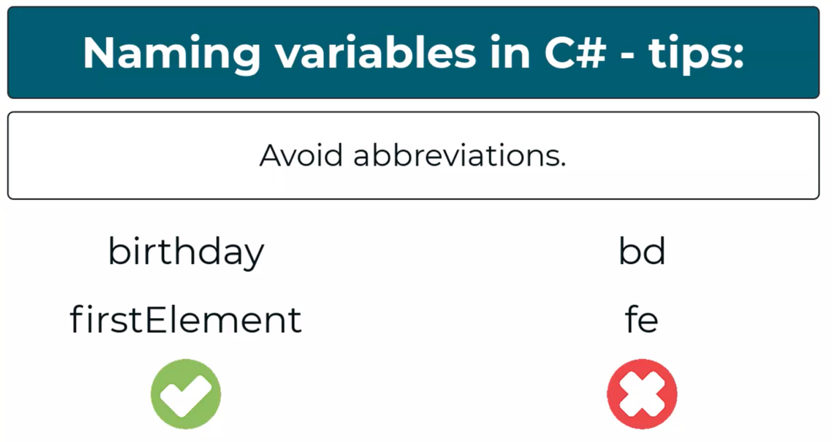
Naming tips

Slide 18
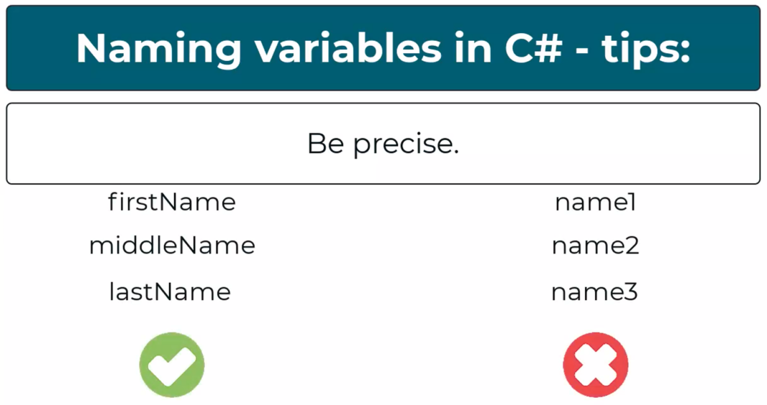
Naming tips

Slide 19
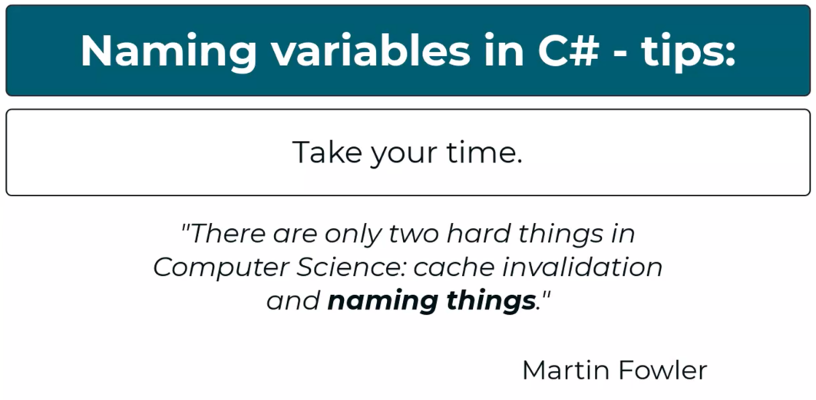
Naming tips

Slide 20
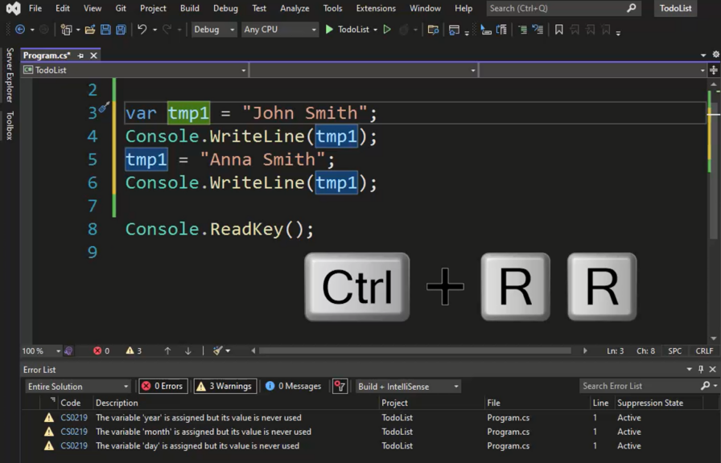
rename

Slide 21
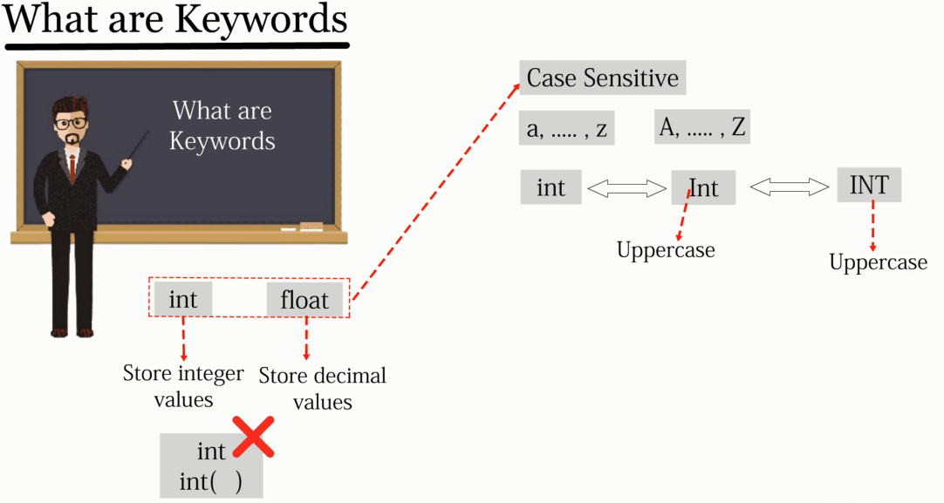
keywords

Slide 22
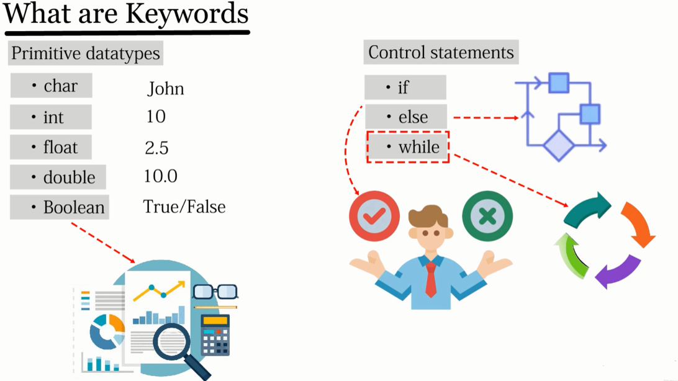
keywords

Slide 23
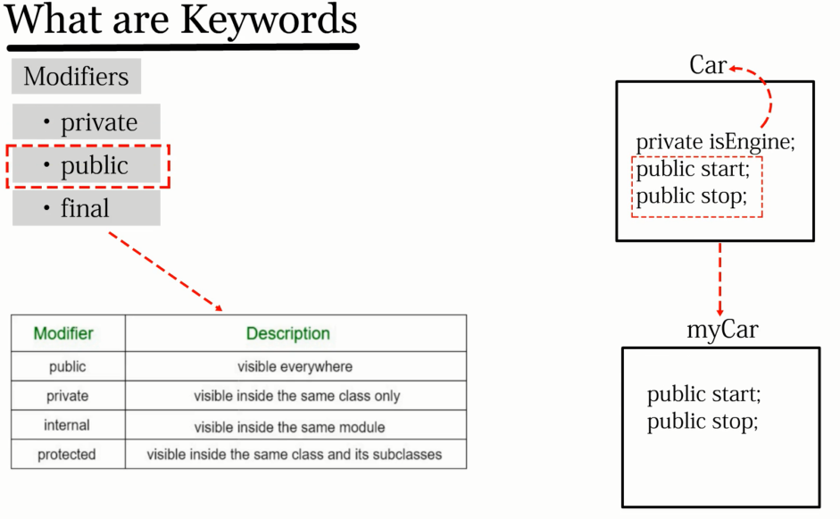
keywords

Slide 24
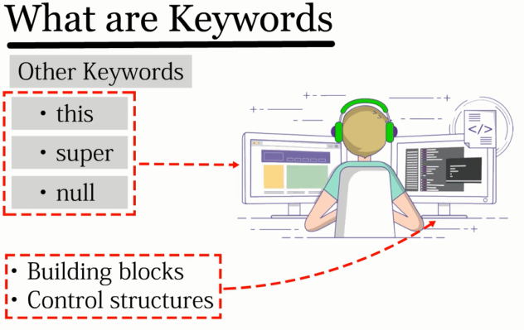
keywords
Notes:
https://learn.microsoft.com/en-us/dotnet/csharp/language-reference/keywords/

Slide 25
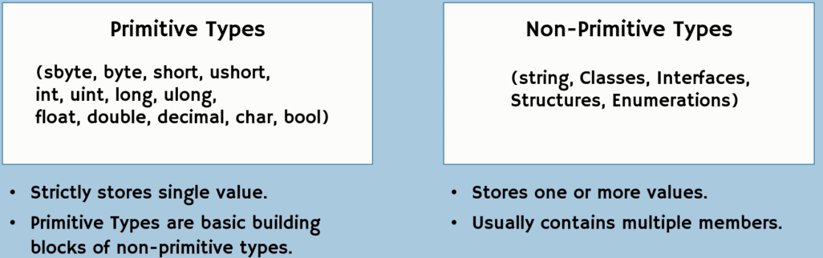
Variables – types and ranges

Slide 26
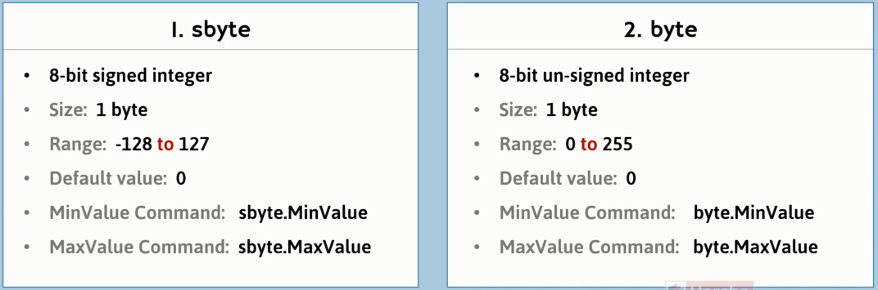
Variables – types and ranges

Slide 27
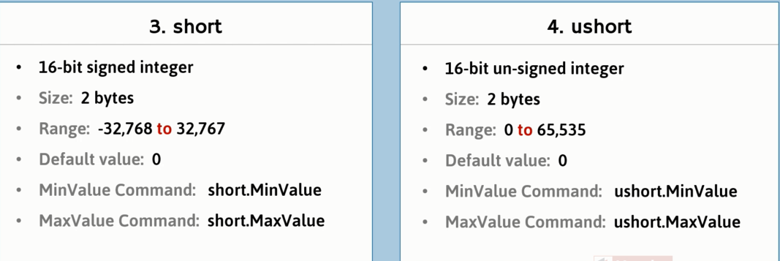
Variables – types and ranges

Slide 28
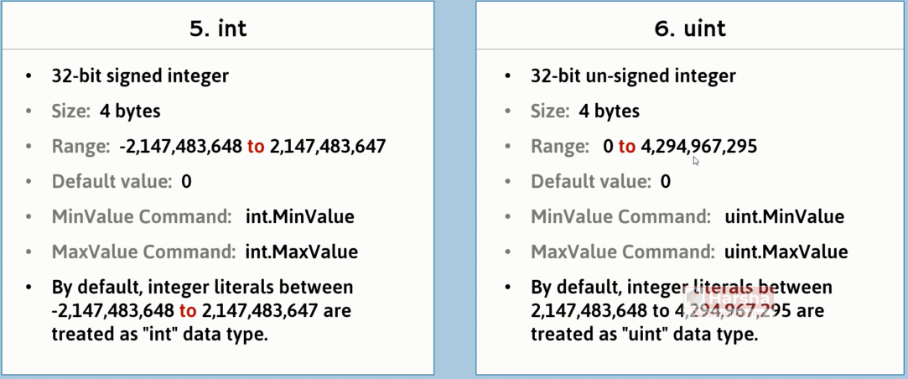
Variables – types and ranges

Slide 29
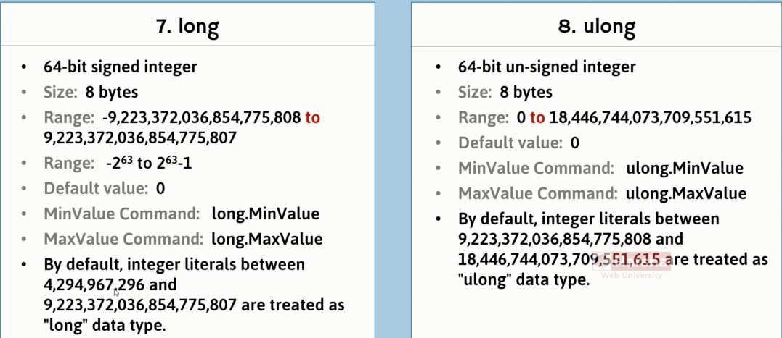
Variables – types and ranges

Slide 30
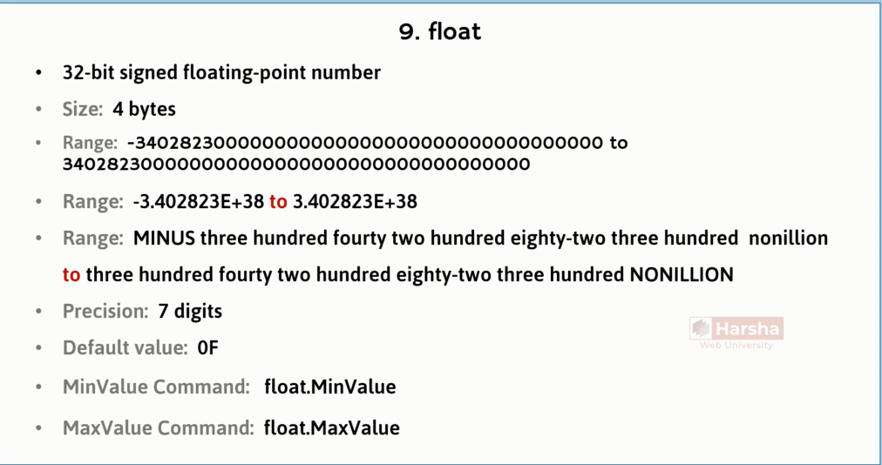
Variables – types and ranges

Slide 31
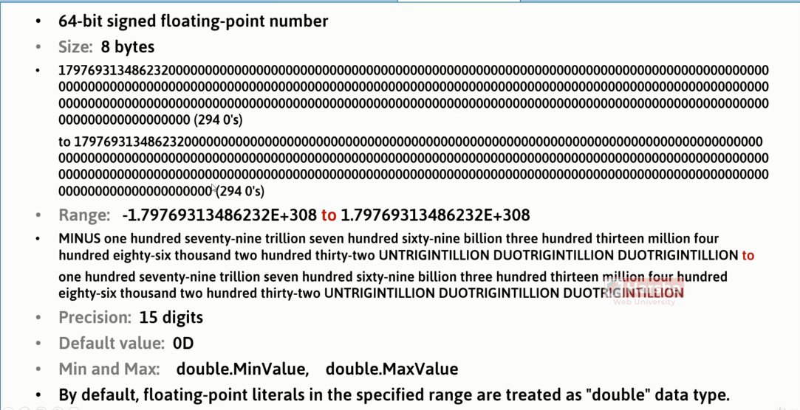
Variables – types and ranges

Slide 32
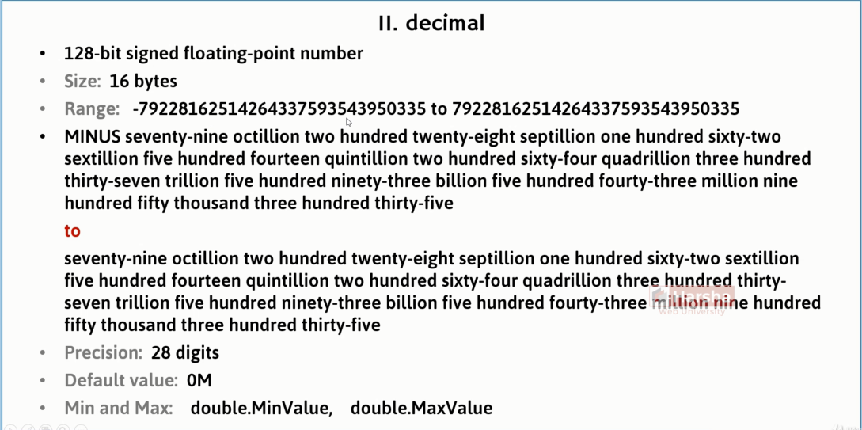
Variables – types and ranges

Slide 33
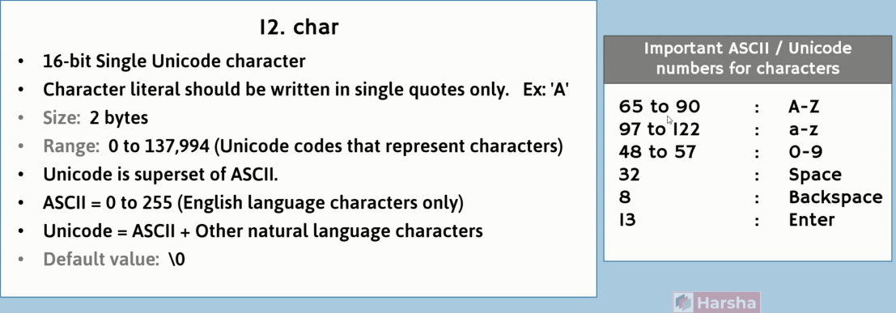
Variables – types and ranges

Slide 34
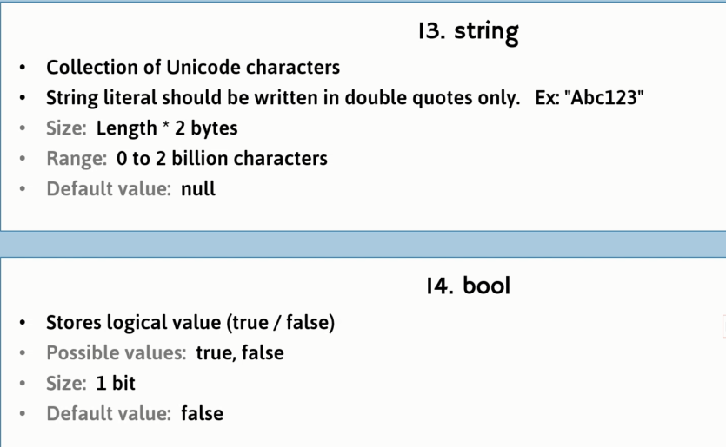
Variables – types and ranges

Slide 35
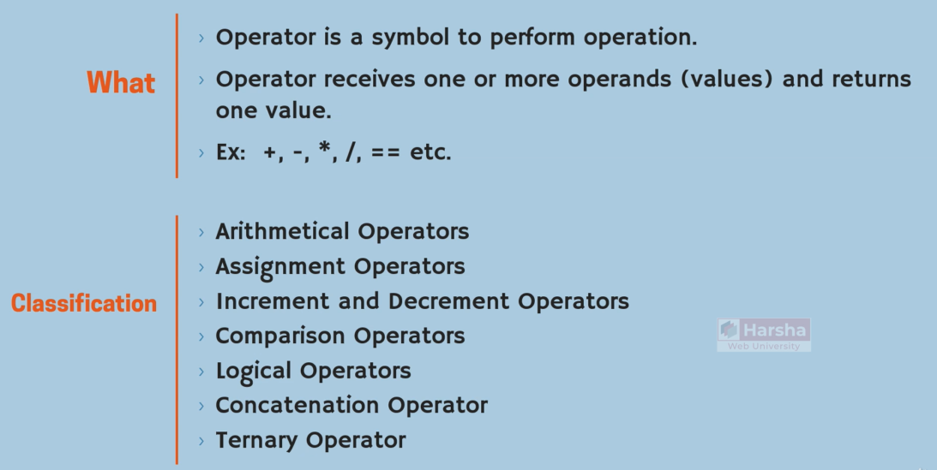
operators

Slide 36
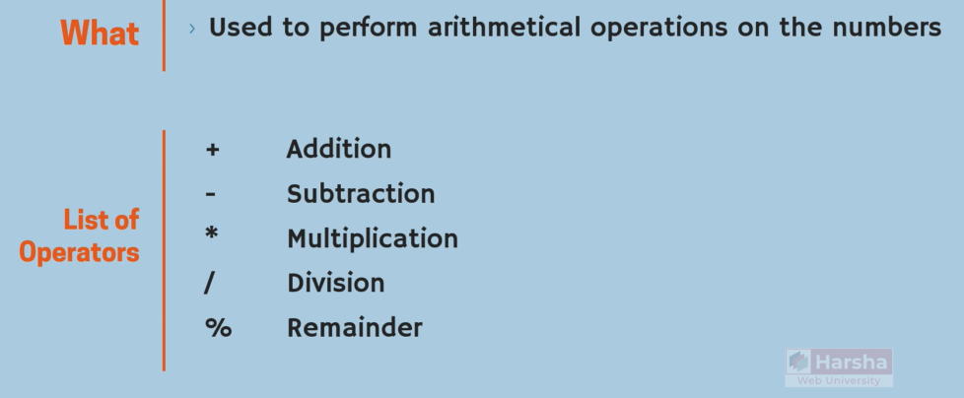
Operators - arithmatic

Slide 37
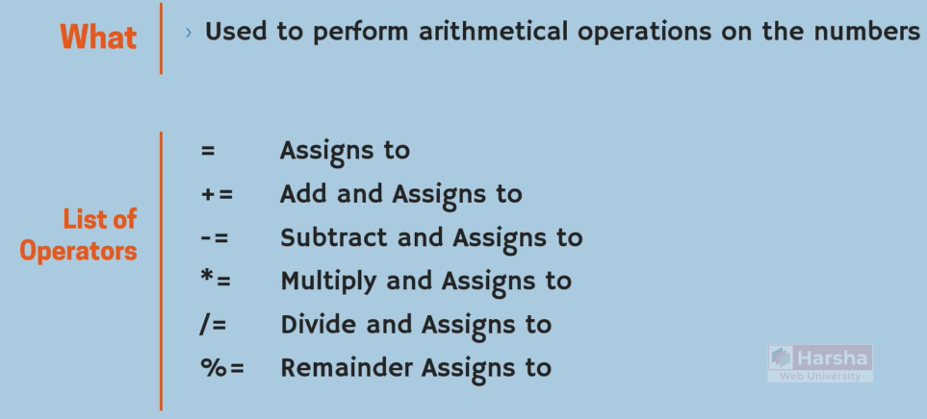
Operators - assignment

Slide 38
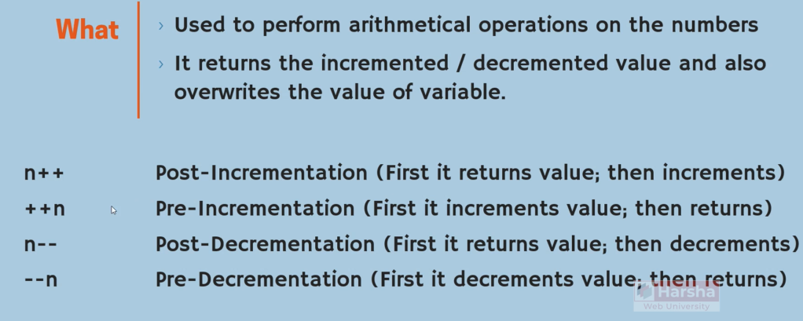
Operators - increment

Slide 39
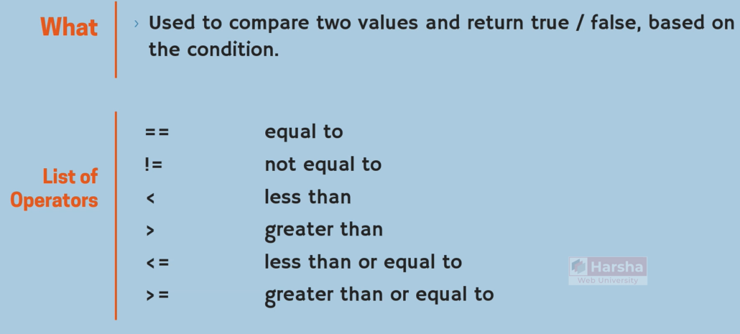
Operators - comparison

Slide 40
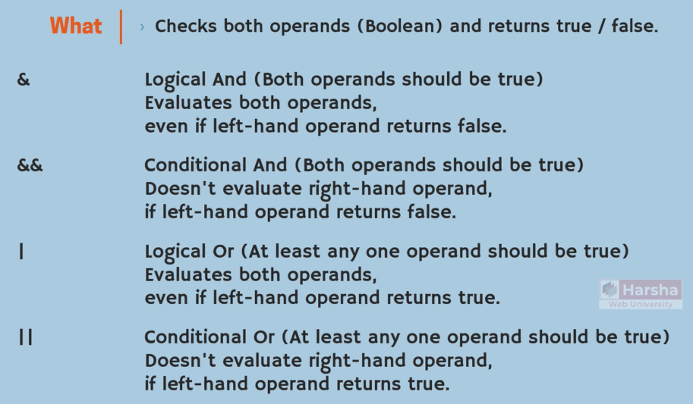
Operators - logical

Slide 41

Operators - logical

Slide 42
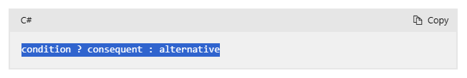
Operators - ternary conditional
Notes:
condition ? consequent : alternative

Slide 43
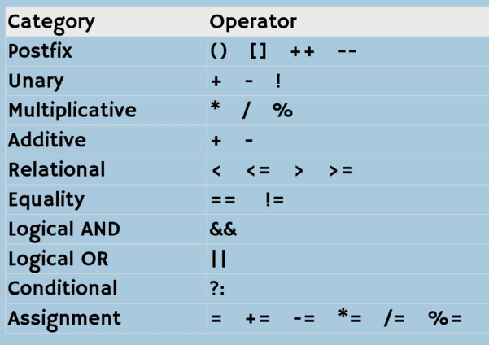
Operators – precedence

Slide 44
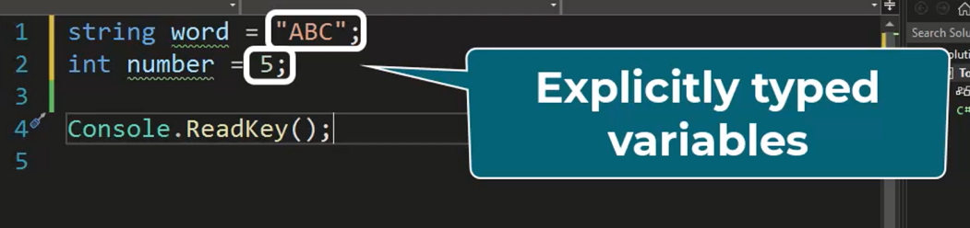
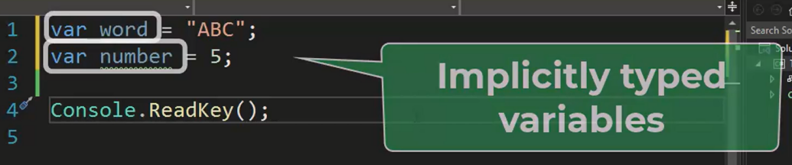
Variables – implicitly & explicitly
Notes:
1- After initialization they can’t be changed.
2- They must be initialized.

Slide 45
Debugging
Breakpoint: for stopping execution on the desired line.
Step over: Line by line – procedures single line – shift + f10
Step into: Line by line – f11
Step out: come back from the procedure - shift+ f11
Quick watch: watch variables – shift+ f9

Slide 46
Comments
// single line comment
/* */ multi line
Ctrl + k c --→ comment
Ctrl + ku -→ uncomment
Alt drag //

Slide 47
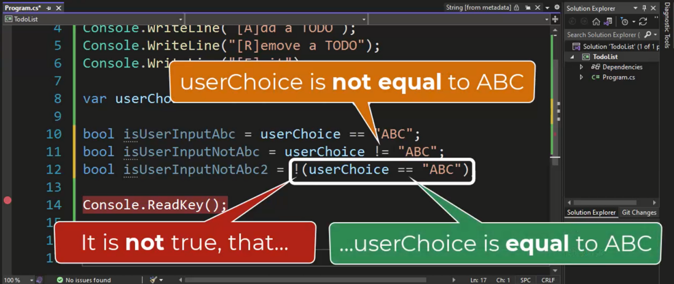
Boolean and Comparisons

Slide 48
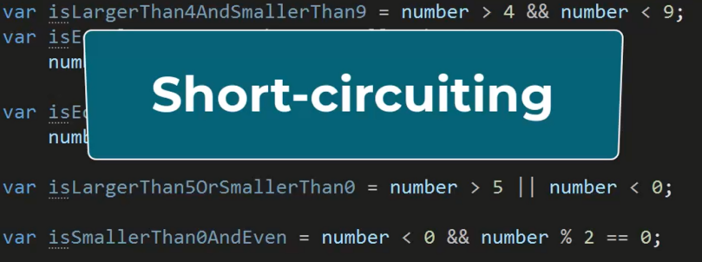
AND-OR, logical operators

Slide 49
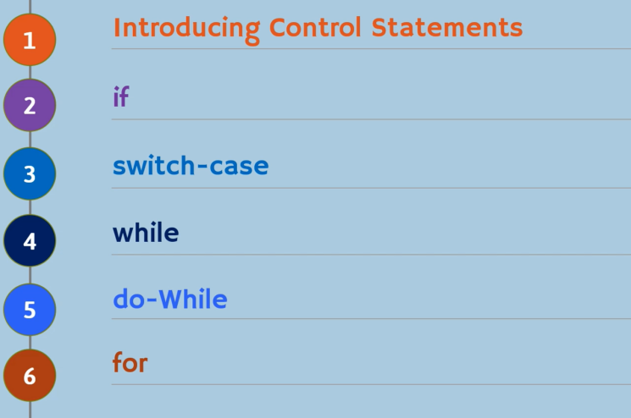
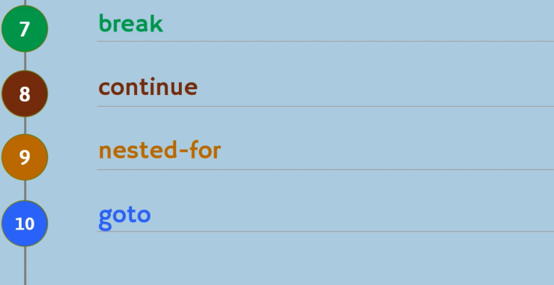
Control statement

Slide 50
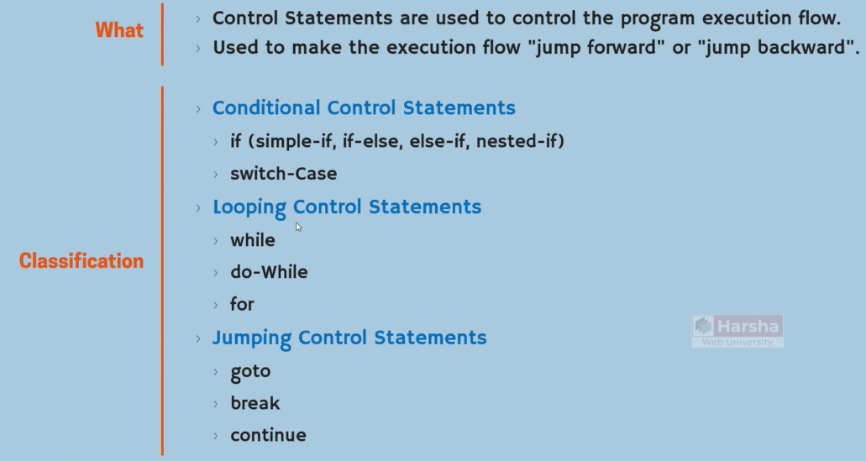
Control statement

Slide 51
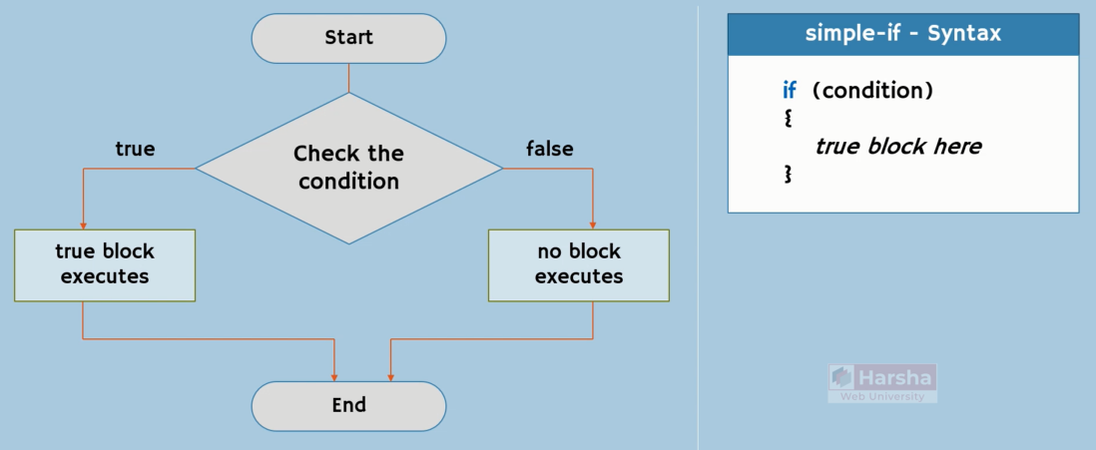
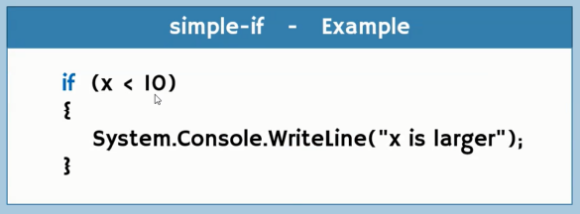
If-else statement
Notes:
Ctrl + k – ctrl D ---→ format codes

Slide 52
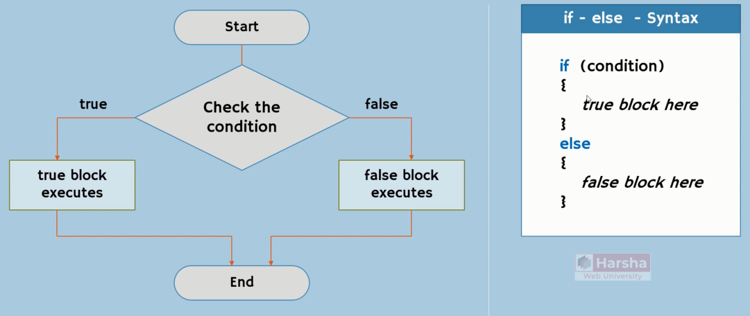

If-else statement
Notes:
Ctrl + k – ctrl D ---→ format codes

Slide 53

If-else statement
Notes:
Ctrl + k – ctrl D ---→ format codes

Slide 54


If-else statement
Notes:
Ctrl + k – ctrl D ---→ format codes

Slide 55

If-else statement
Notes:
Ctrl + k – ctrl D ---→ format codes

Slide 56

If-else statement
Notes:
Ctrl + k – ctrl D ---→ format codes

Slide 57

Switch case

Slide 58

Switch case

Slide 59

Switch case

Slide 60

Switch case

Slide 61

Switch case

Slide 62


Switch case

Slide 63

Need for loops

Slide 64

Loops in c#

Slide 65

While statement

Slide 66

While statement

Slide 67

While statement

Slide 68

Do while statement

Slide 69

Do while statement
Notes:
string result = "";
do
{
result += character;
}
while(result.Length < targetLength);
return result;

Slide 70

For loop

Slide 71

For loop

Slide 72

break

Slide 73

break
break

Slide 74

continue

Slide 75

continue
Continue

Slide 76

continue

Slide 77


Nested – for (loops)
Notes:
for (int i = 1; i <= 5; i++)
{
for (int j = 1; j <= i; j++)
{
System.Console.Write(j);
System.Console.Write(" ");
}
System.Console.WriteLine();
}
System.Console.ReadKey();

Slide 78

Loops performance

Slide 79


Loops performance

Slide 80

Loops performance

Slide 81

goto
Notes:
int i = 1;
System.Console.WriteLine("USA");
System.Console.WriteLine("UK");
System.Console.WriteLine("India");
mylabel:
System.Console.WriteLine("France");
System.Console.WriteLine("Italy");
System.Console.WriteLine("Iran");
i++;
if (i <=5)
{
goto mylabel;
}
System.Console.WriteLine("Nepal");
System.Console.WriteLine("Dubai");
System.Console.ReadKey();

Slide 82

array

Slide 83

array

Slide 84

array

Slide 85


array

Slide 86



array

Slide 87


array

Slide 88

array

Slide 89


array
Notes:
public static int FindMax(int[,] numbers)
{
int height = numbers.GetLength(0);
if(height == 0)
{
return -1;
}
int width = numbers.GetLength(1);
if(width == 0)
{
return -1;
}
int max = numbers[0,0];
for(var i = 0; i < height; ++i)
{
for(var j = 0; j < width; ++j)
{
var number = numbers[i,j];
if(number > max)
{
max = number;
}
}
}
return max;
}

Slide 90

foreach
Notes:
string[] cars = {"Volvo", "BMW", "Ford", "Mazda"};
foreach (string car in cars)
{
Console.WriteLine(car);
}

Slide 91

Variables scope

Slide 92

methods

Slide 93

methods

Slide 94

methods
Notes:
Unlike variables, method’s name start with Capital letters.

Slide 95


methods
Notes:
Definition and Calling.

Slide 96

methods

Slide 97

methods

Slide 98

methods
Notes:
If else return – just if return -→ isLong method

Slide 99

methods
Notes:
Generate method – return input.length > 10

Slide 100

methods

Slide 101

methods

